Slide 1


SOLUTION
In Detail
We offer a product that can allow our users to save more money and earn passive income.
1
2
3
We offer any destination, at any time. We’ve invented a solution to cut down 99% of time & costs.
4
Users can save money and generate commissions on the go through our service and with zero emissions.
Our application connects you with others who are similar and offer you to become a referrer & make money.

Slide 2

SOLUTION
Online Exam Face Detection (OeFD)
In Detail
We offer a product that can allow our users to save more money and earn passive income.
1
2
3
We offer any destination, at any time. We’ve invented a solution to cut down 99% of time & costs.
4
Users can save money and generate commissions on the go through our service and with zero emissions.
Our application connects you with others who are similar and offer you to become a referrer & make money.

Slide 3
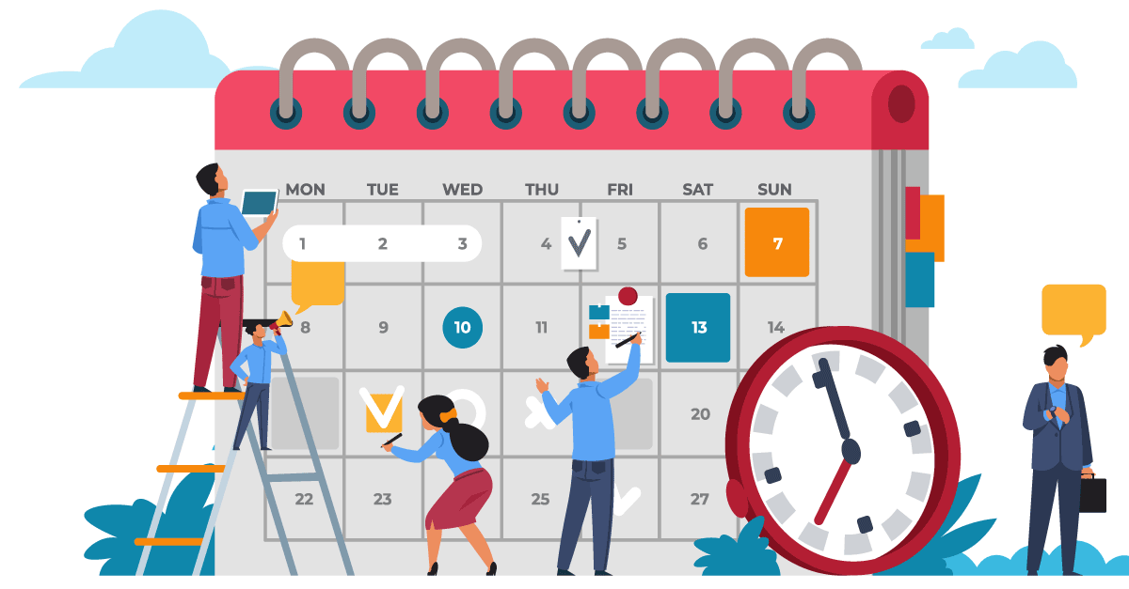
DEFINING
We offer a product that can allow our users to save more money and earn passive income.
1
2
3
We offer any destination, at any time. We’ve invented a solution to cut down 99% of time & costs.
4
Users can save money and generate commissions on the go through our service and with zero emissions.
Our application connects you with others who are similar and offer you to become a referrer & make money.

Slide 4


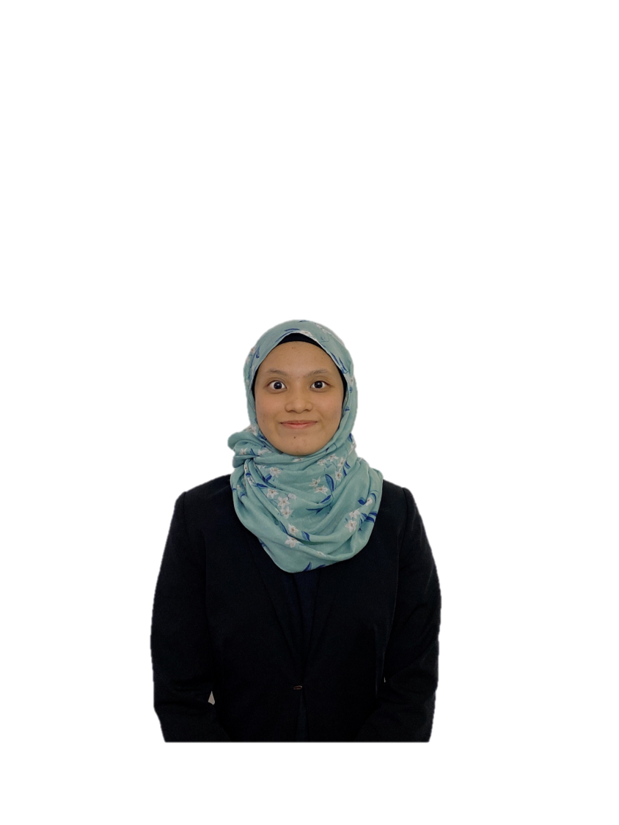
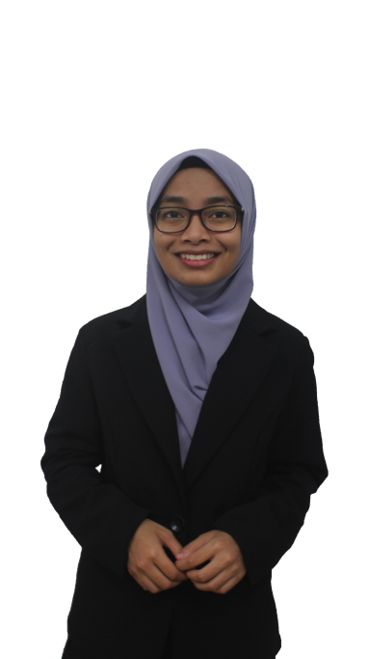
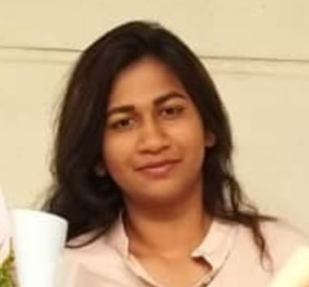
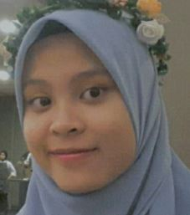
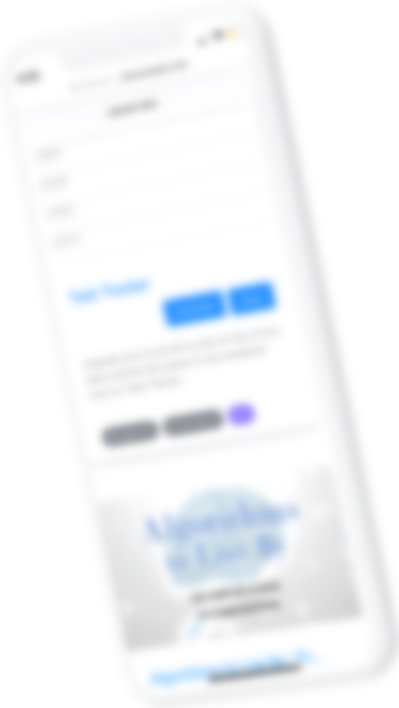
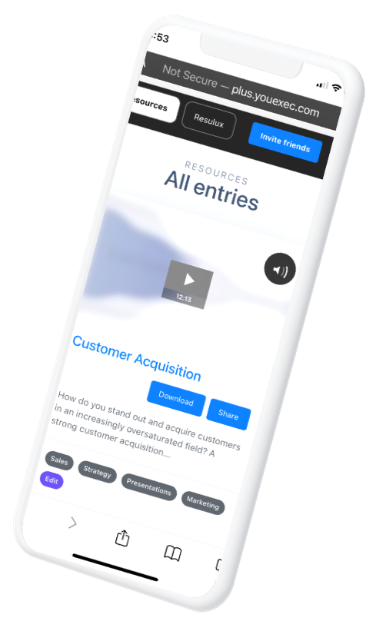
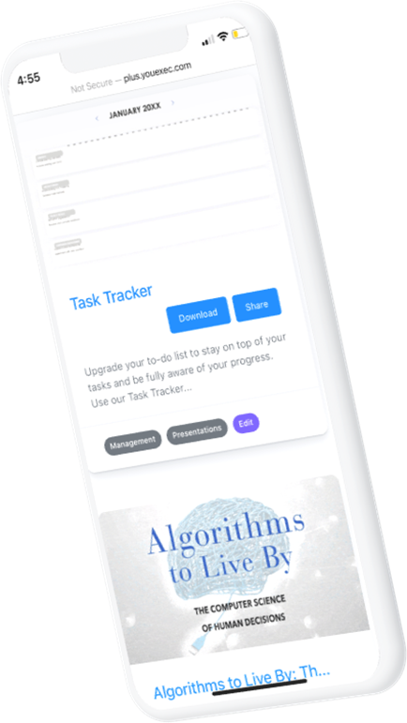
HUMMING BIRD SDN BHD
Product Mockup
Our product features a pleasant user interface that allows a user to complete a transaction under a minute.
Project Manager
Human Resource Manager
Programming Engineer
Financial Analyst
15%
Customers have referred at least one friend who also became a registered user
Nurul Aishah B031910009
Thanushaini B031910159
Nurul 'Izzah
B031910128
Siti Kamariah B031910052
32%
Customers have performed two more more transactions within one year of signing up
PRODUCT MOCKUP
PRODUCT MOCKUP

Slide 5
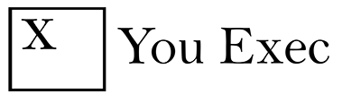
hmppt
Identify registered students by using face recognition
1
OBJECTIVES
Improve security during online exams
2
Promote honesty among students
3
TESTIMONIALS

Slide 6

We offer a product that can allow our users to save more money and earn passive income.
1
SOLUTION
We offer any destination, at any time. We’ve invented a solution to cut down 99% of time & costs.
2
In Detail
3
Users can save money and generate commissions on the go through our service and with zero emissions.
Our application connects you with others who are similar and offer you to become a referrer & make money.
4
TARGET USER

Slide 7
PLANNING
We offer a product that can allow our users to save more money and earn passive income.
1
2
3
We offer any destination, at any time. We’ve invented a solution to cut down 99% of time & costs.
4
Users can save money and generate commissions on the go through our service and with zero emissions.
Our application connects you with others who are similar and offer you to become a referrer & make money.

Slide 8
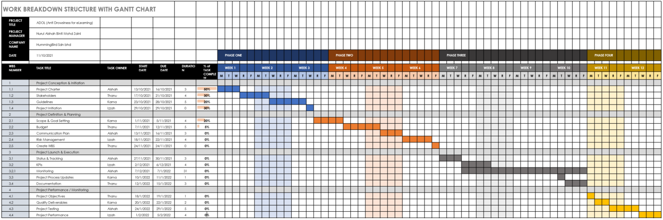
KPI Dashboard
WORK BREAKDOWN STRUCTURE
Revenue Per Client
Client Retention Rate (CRR)
Profit Margin (PM)
20%
50%
75%
LOW PERFORMANCE
MEDIUM PERFORMANCE
HIGH PERFORMANCE
Insert a description text about performance of your business with multiple parameters.
Insert a description text about performance of your business with multiple parameters.
Insert a description text about performance of your business with multiple parameters.
APRIL 20XX
MAY 20XX
JUNE 20XX

Slide 9

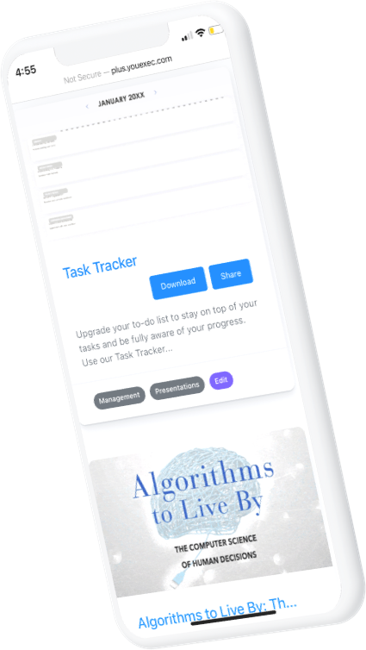
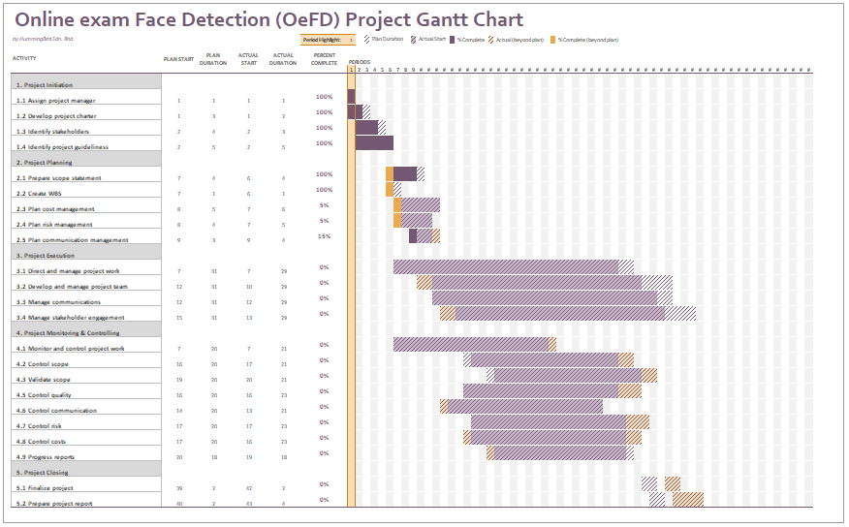
Product Mockup
Our product features a pleasant user interface that allows a user to complete a transaction under a minute.
15%
Customers have referred at least one friend who also became a registered user
PRODUCT MOCKUP
PRODUCT MOCKUP
32%
Customers have performed two more more transactions within one year of signing up
GANTT CHART
66%
Gross Profit Margin
70%
Opex Ratio
30%
EBIT Margin
25%
Net Profit Margin
REVENUE COMPARISON WITH TARGET
OPERATIONAL EXPENSES

Slide 10
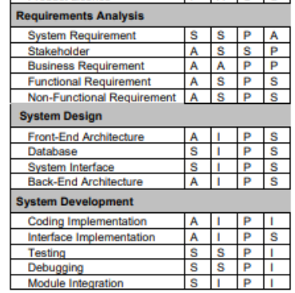
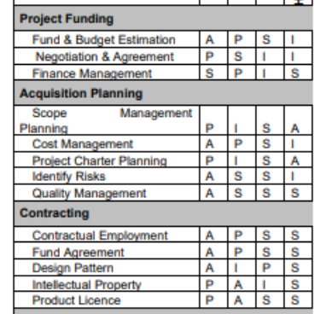
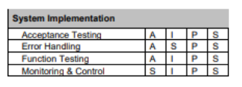
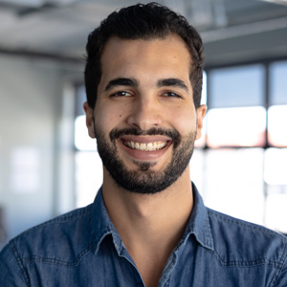

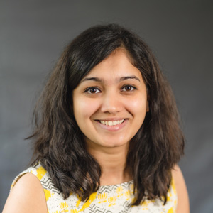
We offer a product that can allow our users to save more money and earn passive income.
1
SOLUTION
We offer any destination, at any time. We’ve invented a solution to cut down 99% of time & costs.
2
In Detail
RESPONSIBILITY ASSIGNMENT MATRICES (RAM)
Users can save money and generate commissions on the go through our service and with zero emissions.
Our application connects you with others who are similar and offer you to become a referrer & make money.
I began using this service one month after it launched. I have made a lot from commissions and referrals.
Peter Beckers
From California
I began using this service one month after it launched. I have made a lot from commissions and referrals.
Regina Thompson
From New York
I began using this service one month after it launched. I have made a lot from commissions and referrals.
Lauren Johnson
From San Francisco

Slide 11
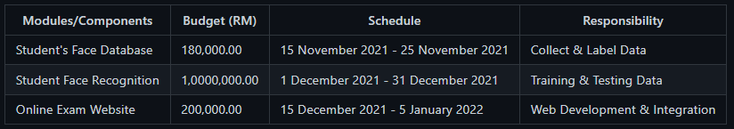
PROJECT PLANNING SUMMARY
Revenue Per Client
Modules
Budget (RM)
Schedule
Responsibility
Client Retention Rate (CRR)
Profit Margin (PM)
20%
50%
75%
LOW PERFORMANCE
MEDIUM PERFORMANCE
HIGH PERFORMANCE
Insert a description text about performance of your business with multiple parameters.
Insert a description text about performance of your business with multiple parameters.
Insert a description text about performance of your business with multiple parameters.
APRIL 20XX
MAY 20XX
JUNE 20XX

Slide 12
Product Mockup
Our product features a pleasant user interface that allows a user to complete a transaction under a minute.
15%
Customers have referred at least one friend who also became a registered user
PRODUCT MOCKUP
PRODUCT MOCKUP
32%
Customers have performed two more more transactions within one year of signing up
Estimated Cost & Task
66%
Gross Profit Margin
70%
Opex Ratio
30%
EBIT Margin
Acquisition
Design
Restoration
REVENUE COMPARISON WITH TARGET
RM 900 000
RM 300 000
RM 180 000
OPERATIONAL EXPENSES
Software, Hardware, Data Collection
System Design, Training & Testing
System Installation, Maintenance

Slide 13

hmppt
IMPLEMENTING
TESTIMONIALS

Slide 14
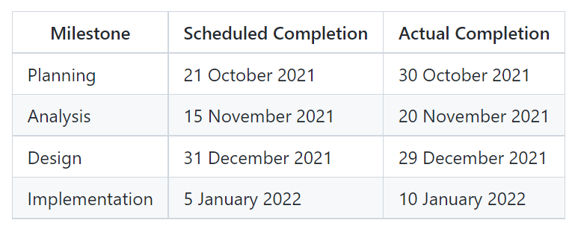
MILESTONE CHART
Product Mockup
Our product features a pleasant user interface that allows a user to complete a transaction under a minute.
15%
Customers have referred at least one friend who also became a registered user
32%
Customers have performed two more more transactions within one year of signing up
PRODUCT MOCKUP
PRODUCT MOCKUP

Slide 15

CLOSING
We offer a product that can allow our users to save more money and earn passive income.
1
2
3
We offer any destination, at any time. We’ve invented a solution to cut down 99% of time & costs.
4
Users can save money and generate commissions on the go through our service and with zero emissions.
Our application connects you with others who are similar and offer you to become a referrer & make money.

Slide 16
LESSON LEARNT
The team, as a whole, learned several lessons throughout this project. Having stakeholder involves throughout the life cycle enable to make known their views and to work together to ensure that these views are considered to met business and technical requirements. Besides that, a skilled Project Manager is essential to manage resources, engage suppliers, and deal with team conflict.

Slide 17
WHAT WENT RIGHT ?
Many things have went right throughout the project. Good planning paid off in execution. We spent a fair amount of time developing a good project charter, scope statement, WBS, Gantt Chart, and so on. Everyone worked together to develop these planning documents. Besides that, a competent team have perform all the activities within a project environment to expected and recognized standards to met satisfy stakeholders and met project success criteria.
SOLUTION
In Detail
We offer a product that can allow our users to save more money and earn passive income.
1
2
3
We offer any destination, at any time. We’ve invented a solution to cut down 99% of time & costs.
4
Users can save money and generate commissions on the go through our service and with zero emissions.
Our application connects you with others who are similar and offer you to become a referrer & make money.

Slide 18
WHAT WENT WRONG ?
Implementation of the system has experienced many problems. Since none of the team member has expertise in Python programming language, we have to collect a lot of resources such as tutorials and programming books and also refer to senior programmer to assist in the implementation. Luckily, we able to complete the implementation phase within the time schedule.
SOLUTION
In Detail
We offer a product that can allow our users to save more money and earn passive income.
1
2
3
We offer any destination, at any time. We’ve invented a solution to cut down 99% of time & costs.
4
Users can save money and generate commissions on the go through our service and with zero emissions.
Our application connects you with others who are similar and offer you to become a referrer & make money.

Slide 19
THANK
YOU

